Slide 1
Basics of a Terraced Retaining Wall
How to Get Started With a D.I.Y. Project
By Andrew Glasgow
Owner D.I.Y. Alaskan Landscaping
October 6. 20015

Slide 2
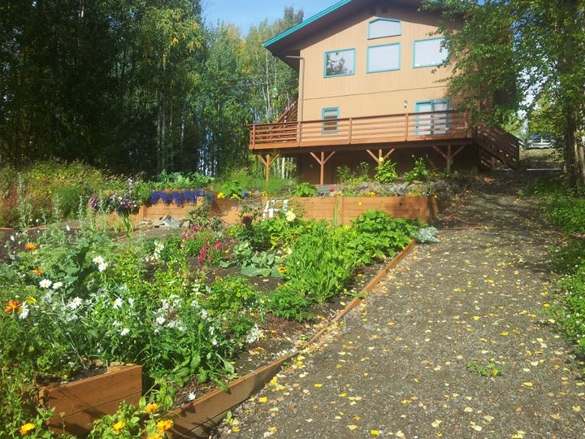
Project Outline
1. Introduction
2. Site Selection
3. Site Preparation
4. Construction
5. Back Fill & Finishing Touches
6. Conclusion
October 6, 2015

Slide 3
Introduction
Landscaping on a hillside can be an intimidating project. Terraced retaining walls offer an attractive and functional option for homeowners who desire to utilize their property more efficiently.
A D.I.Y. or” Do It Yourself” project can be a great way for a homeowner to save money, and be a rewarding endeavor!
The following presentation will:
Outline the basic steps needed for you as a homeowner to terrace your sloped property.
Create a more usable and attractive space.
October 6, 2015

Slide 4
Site Selection
Not all hillsides are created equal.
You will need to choose an area that:
Is not too steep.
Is not exposed to excessive run off from rain or other water sources.
Is stable and not prone to landslides or “sluffing”.
Has access for equipment such as a skid steer , small excavator or small truck.
October 6, 2015

Slide 5
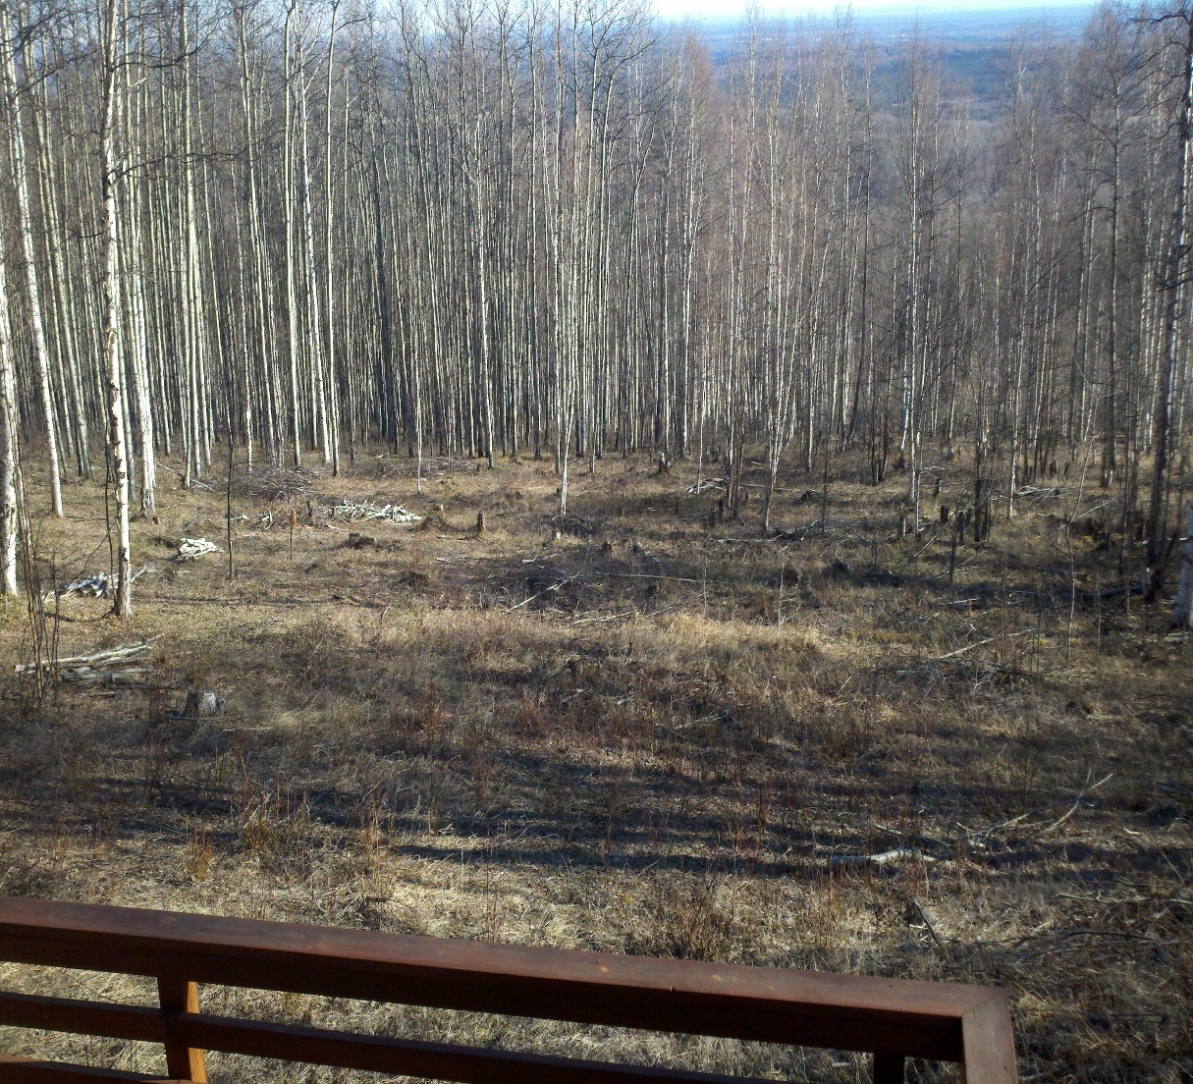
Site Selection cont’d…
Choosing a site really comes down to 3 simple tests.
Can you walk down it without falling or needing a rope?
When it rains do you have a temporary stream?
Does the ground give way or slide out from under you when you walk on it?
If any of the previous things occur, you will want to select another spot, or hire a very expensive contractor with good insurance.
October 6, 2015

Slide 6
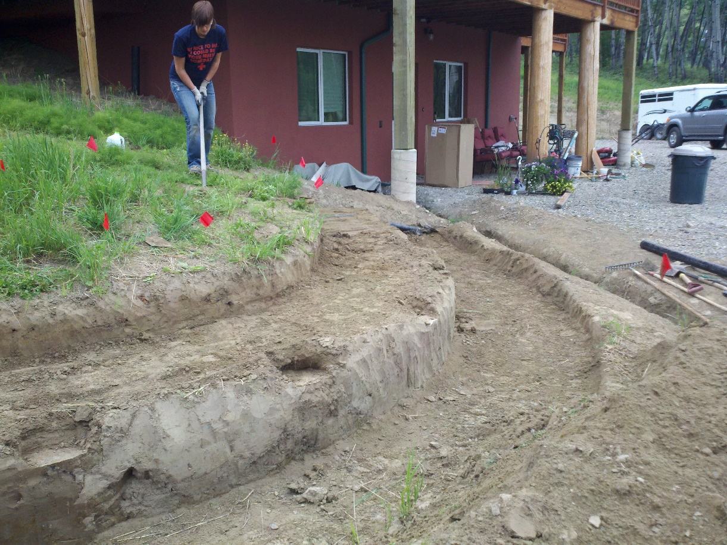
Site Preparation
Once you have your site selected, it is time to start your prep work.
Preparation has 3 stages
1. Design. This is the plans for your walls and levels
2. Layout Marking. Using tape, flagging, spray-paint and other materials to transfer your design to the ground.
3. Excavation. Using equipment or manual labor to cut the shape of the terracing plan into the hillside.
October 6, 2015

Slide 7
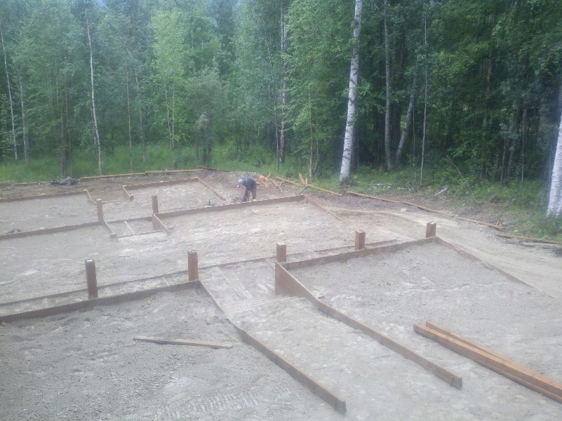
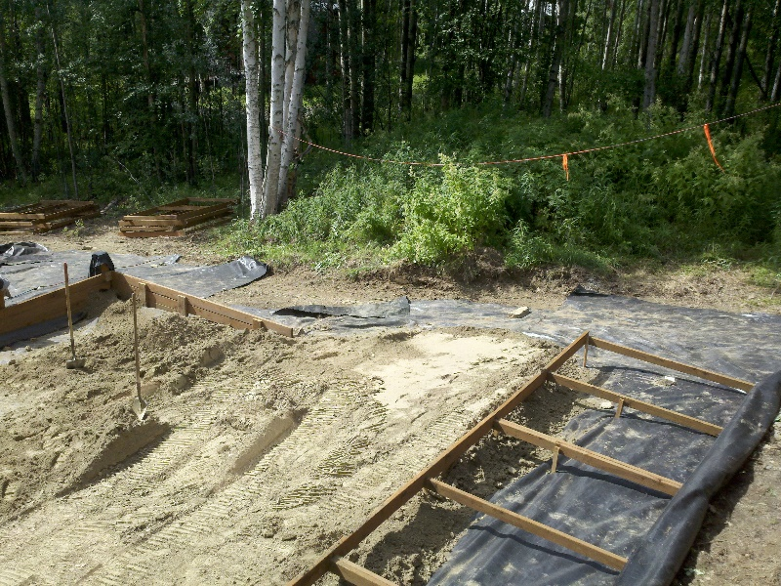
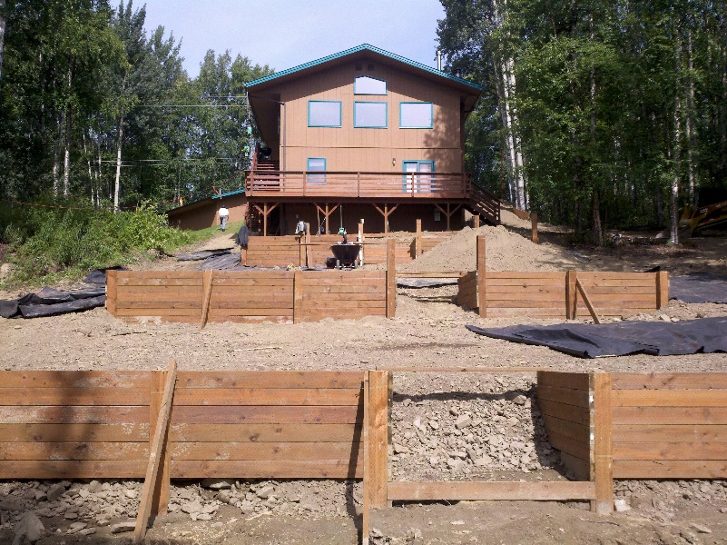
Construction
The construction phase breaks down into 3 stages.
Foundation. Every structure needs a solid foundation to stand on. Especially if it is supporting a hillside behind it.
Framing. Whether your wall is wood, stone or steel, it will need a solid frame designed to take the weight of the wall and whatever is behind it.
Finish work. This is where you build the actual wall .
October 6, 2015

Slide 8
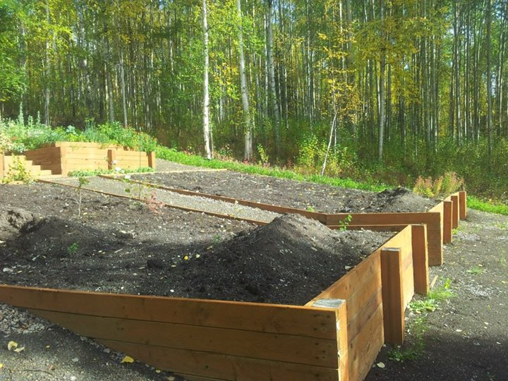
Back-Fill & Finishing Touches
Once the wall is constructed, It is time to back-fill the space for whatever purpose you have decided to use it for.
The type of fill or soil you use will depend on your intended final use.
Options include:
Lawn Space.
Vegetable gardens.
Flower beds.
October 6, 2015

Slide 9
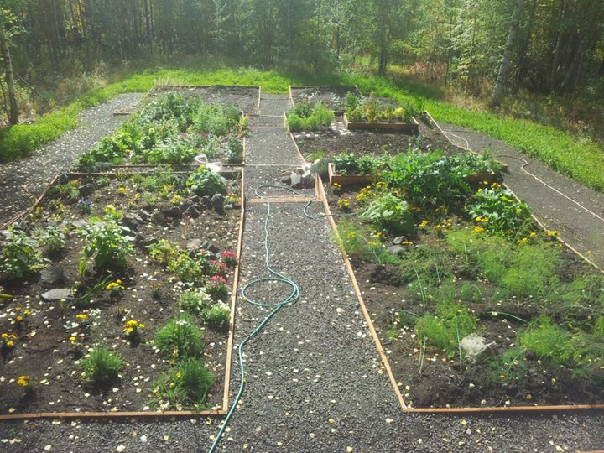
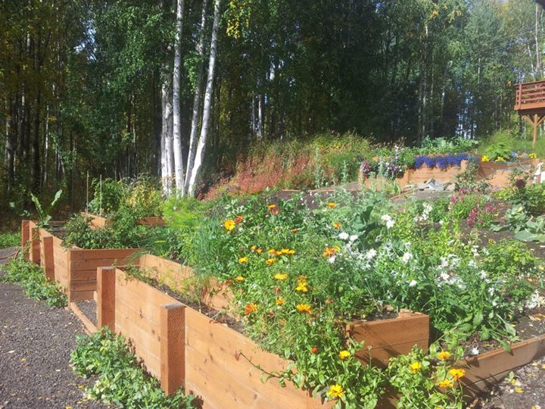
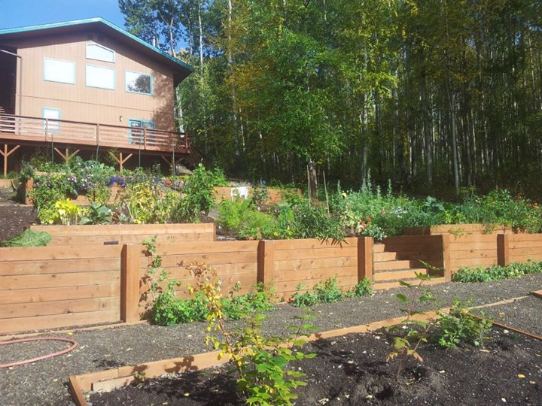
Conclusion
Building your own terraced walls is a big project. With the right amount of planning and some hard work however, it can be a satisfying project for the D.I.Y oriented homeowner.
The directions we have discussed will help you focus your planning and research to give you the results and yard you have imagined in your dreams
October 6, 2015

Slide 10
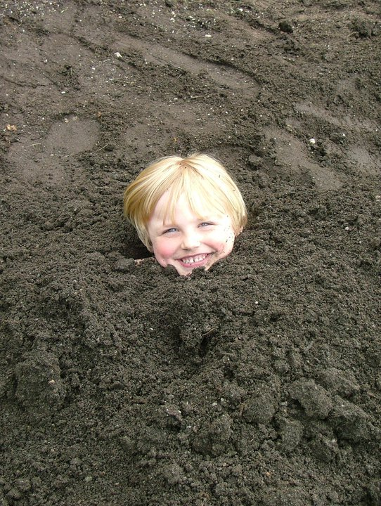
Questions???
October 6, 2015

